Slide 1


Principles of Information Security
Sixth Edition
Chapter 10
Implementing Information Security
Copyright © 2018 Cengage. May not be copied, scanned, or duplicated, in whole or in part, except for use as permitted in a license distributed with a certain product or service or otherwise on a password-protected website for classroom use.

Slide 2
Learning Objectives
Upon completion of this material, you should be able to:
Explain how an organization’s information security blueprint becomes a project plan
Discuss the many organizational considerations that a project plan must address
Explain the significance of the project manager’s role in the success of an information security project
Describe the need for professional project management for complex projects
Discuss technical strategies and models for implementing a project plan
List and discuss the nontechnical problems that organizations face in times of rapid change
Notes:
Learning Objectives
Upon completion of this material, you should be able to:
Explain how an organization’s information security blueprint becomes a project plan
Discuss the many organizational considerations that a project plan must address
Explain the significance of the project manager’s role in the success of an information security project
Describe the need for professional project management for complex projects

Slide 3
Introduction
InfoSec blueprint implementation is accomplished by changing the configuration and operation of an organization’s information systems.
Implementation includes changes to:
Procedures (through policy)
People (through training)
Hardware (through firewalls)
Software (through encryption)
Data (through classification)
Organization translates its blueprint for information security into a project plan.
Notes:
Introduction
SecSDLC implementation phase is accomplished by changing the configuration and operation of organization’s information systems
Implementation includes changes to:
Procedures (through policy)
People (through training)
Hardware (through firewalls)
Software (through encryption)
Data (through classification)
Organization translates blueprint for information security into a project plan

Slide 4
Information Security Project Management
Project plan must address project leadership, managerial/technical/budgetary considerations, and organizational resistance to change.
Major steps in executing a project plan are:
Planning the project
Supervising tasks and action steps
Wrapping up
Each organization must determine its own project management methodology for IT and information security projects.
Notes:
Project Management in the Implementation Phase
Project plan must address project leadership, managerial/technical/budgetary considerations, and organizational resistance to change
Major steps in executing project plan are:
Planning the project
Supervising tasks and action steps
Wrapping up
Each organization must determine its own project management methodology for IT and information security projects

Slide 5
Developing the Project Plan
Creation of a project plan can be done using a tool such as the work breakdown structure (WBS).
Major project tasks in WBS are:
Work to be accomplished (activities and deliverables)
The people or skill sets assigned to perform the task
Start and end dates for the task, when known
Amount of effort required for completion, in hours or work days
Estimated capital expenses for the task
Estimated noncapital expenses for the task
Identification of dependencies between and among tasks
Each major WBS task is further divided into smaller tasks or specific action steps.
Notes:
Developing the Project Plan
Creation of project plan can be done using work breakdown structure (WBS)
Major project tasks in WBS are:
Work to be accomplished
People/skill sets assigned
Start and end dates
Amount of effort required
Estimated capital and noncapital expenses
Identification of dependencies between/among tasks
Each major WBS task is further divided into smaller tasks or specific action steps

Slide 6
Table 10-1 Example Project Plan Work Breakdown Structure (1 of 4)
Task or Subtask | Resources | Start (S) & End (E) Dates | Estimated Effort in Hours | Estimated Capital Expense | Estimated Non capital Expense | Depend-encies
1 Contact field office and confirm network assumptions | Network architect | S: 9/22 E: 9/22 | 2 | $0 | $200
2 Purchase standard firewall hardware
2.1 Order firewall through purchasing group | Network architect | S: 9/23 E: 9/23 | 1 | $0 | $100 | 1

Slide 7
Table 10-1 Example Project Plan Work Breakdown Structure (2 of 4)
Task or Subtask | Resources | Start (S) & End (E) Dates | Estimated Effort in Hours | Estimated Capital Expense | Estimated Non capital Expense | Depend-encies
2.2 Order firewall from manufacturer | Purchasing group | S: 9/24 E: 9/24 | 2 | $4,500 | $100 | 2.1
2.3 Firewall delivered | Purchasing group | E: 10/3 | 1 | $0 | $50 | 2.2
3 Configure firewall | Network architect | S: 10/3 E: 10/5 | 8 | $0 | $800 | 2.3
4 Package and ship firewall to field office | Student intern | S: 10/6 E: 10/15 | 2 | $0 | $85 | 3

Slide 8
Table 10-1 Example Project Plan Work Breakdown Structure (3 of 4)
Task or Subtask | Resources | Start (S) & End (E) Dates | Estimated Effort in Hours | Estimated Capital Expense | Estimated Non capital Expense | Depend-encies
5 Work with local technical resource to install and test | Network architect | S: 10/22 E: 10/31 | 6 | $0 | $600 | 4
6 Penetration test
6.1 Request penetration test | Network architect | S: 11/1 E: 11/1 | 1 | $0 | $100 | 5
6.2 Perform penetration test | Penetration test team | S: 11/2 E: 11/12 | 9 | $0 | $900 | 6.1

Slide 9
Table 10-1 Example Project Plan Work Breakdown Structure (4 of 4)
Task or Subtask | Resources | Start (S) & End (E) Dates | Estimated Effort in Hours | Estimated Capital Expense | Estimated Non capital Expense | Depend-encies
6.3 Verify that result of penetration test were passing | Network architect | S: 11/13 E: 11/15 | 2 | $0 | $200 | 6.2
7. Get remote office sign-off and update all network drawings and documents | Network architect | S: 11/16 E: 11/30 | 8 | $0 | $800 | 6.2

Slide 10
Project Planning Considerations (1 of 8)
As project plan is developed, adding detail is not always straightforward.
Special considerations include financial, priority, time and schedule, staff, procurement, organizational feasibility, training and indoctrination, and scope.
Notes:
Project Planning Considerations
As project plan is developed, adding detail is not always straightforward
Special considerations include financial, priority, time and schedule, staff, procurement, organizational feasibility, training and indoctrination, and scope

Slide 11
Project Planning Considerations (2 of 8)
Financial considerations
Regardless of existing information security needs, the amount of effort that can be expended depends on available funds
Cost-benefit analysis must be reviewed and verified prior to the development of a project plan
Both public and private organizations have budgetary constraints, though of a different nature
To justify an amount budgeted for a security project at either public or for-profit organizations, it may be useful to benchmark expenses of similar organizations
Notes:
Financial Considerations
Regardless of existing information security needs, the amount of effort that can be expended depends on available funds
Cost benefit analysis must be reviewed and verified prior to development of project plan
Both public and private organizations have budgetary constraints, though of a different nature
To justify an amount budgeted for a security project at either public or for-profit organizations, it may be useful to benchmark expenses of similar organizations

Slide 12
Project Planning Considerations (3 of 8)
Priority considerations
In general, the most important information security controls should be scheduled first
Implementation of controls is guided by the prioritization of threats and value of threatened information assets
Notes:
Priority Considerations
In general, the most important information security controls should be scheduled first
Implementation of controls is guided by prioritization of threats and value of threatened information assets

Slide 13
Project Planning Considerations (4 of 8)
Time and scheduling considerations
Time impacts project plans at dozens of points, including:
Time to order, receive, install, and configure security control
Time to train the users
Time to realize control’s return on investment
Notes:
Time and Scheduling Considerations
Time impacts project plans at dozens of points, including:
Time to order, receive, install, and configure security control
Time to train the users
Time to realize control’s return on investment

Slide 14
Project Planning Considerations (5 of 8)
Staffing considerations
Need for qualified, trained, and available personnel constrains project plan
Experienced staff is often needed to implement technologies and develop and implement policies and training programs
Procurement considerations
Often constraints on the selection of equipment/services
Some organizations require use of particular service vendors/manufacturers/suppliers
These constraints may limit which technologies can be acquired
Notes:
Staffing considerations
Need for qualified, trained, and available personnel constrains project plan
Experienced staff is often needed to implement technologies and develop and implement policies and training programs
Procurement considerations
Often constraints on selection of equipment/services
Some organizations require use of particular service vendors/manufacturers/suppliers
These constraints may limit which technologies can be acquired

Slide 15
Project Planning Considerations (6 of 8)
Organizational feasibility considerations
Changes should be transparent to system users unless the new technology is intended to change procedures (e.g., requiring additional authentication or verification)
Successful project requires that an organization be able to assimilate proposed changes
New technologies sometimes require new policies, employee training, and education
Notes:
Organizational Feasibility Considerations
Changes should be transparent to system users unless the new technology is intended to change procedures (e.g., requiring additional authentication or verification)
Successful project requires that organization be able to assimilate proposed changes
New technologies sometimes require new policies, employee training, and education

Slide 16
Project Planning Considerations (7 of 8)
Training and indoctrination considerations
Size of an organization and the normal conduct of business may preclude a large training program for new security procedures/technologies
If so, the organization should conduct a phased-in or pilot implementation
Notes:
Training and Indoctrination Considerations
Size of organization and normal conduct of business may preclude a large training program for new security procedures/technologies
If so, organization should conduct phased-in or pilot implementation

Slide 17
Project Planning Considerations (8 of 8)
Scope considerations
Project scope: description of project’s features, capabilities, functions, and quality level, used as the basis of a project plan
Organizations should implement large information security projects in stages
Notes:
Scope Considerations
Project scope: description of project’s features, capabilities, functions, and quality level, used as the basis of a project plan
Organizations should implement large information security projects in stages

Slide 18
The Need for Project Management (1 of 5)
Project management requires a unique set of skills and thorough understanding of a broad body of specialized knowledge.
Most information security projects require a trained project manager (a CISO) or skilled IT manager trained in project management techniques.
Notes:
The Need for Project Management
Project management requires a unique set of skills and thorough understanding of a broad body of specialized knowledge
Most information security projects require a trained project manager (a CISO) or skilled IT manager trained in project management techniques

Slide 19
The Need for Project Management (2 of 5)
Supervised implementation
Some organizations may designate a champion from general management community of interest to supervise the implementation of an information security project plan
An alternative is to designate a senior IT manager or CIO to lead implementation
Best solution is to designate a suitable person from information security community of interest
In final analysis, each organization must find the project leadership best suited to its specific needs
Notes:
Supervised Implementation
Some organizations may designate champion from general management community of interest to supervise implementation of information security project plan
An alternative is to designate senior IT manager or CIO to lead implementation
Best solution is to designate a suitable person from information security community of interest
In final analysis, each organization must find project leadership best suited to its specific needs

Slide 20
The Need for Project Management (3 of 5)
Executing the plan
A negative feedback loop ensures that project progress is measured periodically
When significant deviation occurs, corrective action is taken
Often, a project manager can adjust one of three planning parameters for the task being corrected:
Effort and money allocated
Elapsed time/Scheduling impact
Quality or quantity of deliverable
Notes:
Executing the Plan
Negative feedback loop ensures project progress is measured periodically
When significant deviation occurs, corrective action taken
Often, project manager can adjust one of three planning parameters for task being corrected:
Effort and money allocated
Elapsed time/Scheduling impact
Quality or quantity of deliverable

Slide 21
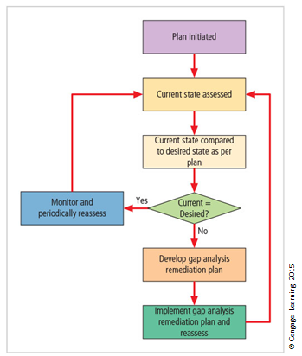
Figure 10-1 Gap analysis (4 of 5)

Slide 22
The Need for Project Management (5 of 5)
Project wrap-up
Project wrap-up is usually handled as a procedural task and assigned to a mid-level IT or information security manager
Collect documentation, finalizes status reports, and delivers final report and presentation at wrap-up meeting
Goal of wrap-up is to resolve any pending issues, critique overall project effort, and draw conclusions about how to improve process
Notes:
Project Wrap-up
Project wrap-up is usually handled as procedural task and assigned to mid-level IT or information security manager
Collect documentation, finalize status reports, and deliver final report and presentation at wrap-up meeting
Goal of wrap-up is to resolve any pending issues, critique overall project effort, and draw conclusions about how to improve process

Slide 23
Security Project Management Certifications
GIAC certified project manager
Offered by SANS Institute; focuses on security professionals/managers with project management responsibilities
IT security project management
Offered by EC Council as a milestone in its Certified E-Business Professional program
Certified security project manager
Security Industry Association focused on physical security; also incorporates information security
Notes:
Security Project Management Certifications
GIAC certified project manager
Offered by SANS Institute; focuses on security professionals/managers with project management responsibilities
IT security project management
Offered by EC Council as a milestone in its Certified E-Business Professional program
Certified security project manager
Security Industry Association focused on physical security; also incorporates information security

Slide 24
Technical Aspects of Implementation
Some aspects of implementation process are technical and deal with the application of technology.
Others deal with human interface to technical systems.
Notes:
Technical Topics of Implementation
Some parts of the implementation process are technical in nature, dealing with the application of technology, while others are not, dealing instead with the human interface to technical systems.

Slide 25
Conversion Strategies (1 of 2)
As the components of the new security system are planned, provisions must be made for changeover from the previous method of performing a task to the new method.
Four basic approaches:
Direct changeover
Phased implementation
Pilot implementation
Parallel operations
Notes:
Conversion Strategies
As components of new security system are planned, provisions must be made for changeover from previous method of performing task to new method
Four basic approaches:
Direct changeover
Phased implementation
Pilot implementation
Parallel operations

Slide 26
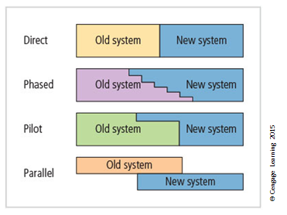
Figure 10-2 Conversion strategies (2 of 2)
Notes:
Conversion Strategies
As components of new security system are planned, provisions must be made for changeover from previous method of performing task to new method
Four basic approaches:
Direct changeover
Phased implementation
Pilot implementation
Parallel operations

Slide 27
The Bull’s-Eye Model (1 of 2)
Proven method for prioritizing program of complex change.
Requires that issues be addressed from general to specific; focus is on systematic solutions and not on individual problems.
Relies on the process of project plan evaluation in four layers:
Policies
Networks
Systems
Applications
Notes:
The Bull’s-Eye Model
Proven method for prioritizing program of complex change
Requires that issues be addressed from general to specific; focus is on systematic solutions and not individual problems
Relies on process of project plan evaluation infour layers:
Policies
Networks
Systems
Applications

Slide 28
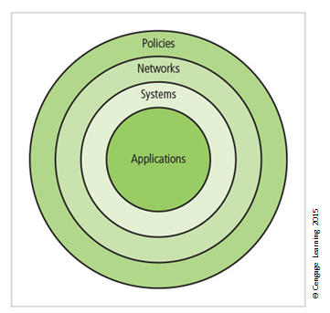
Figure 10-3 The bull’s-eye model (2 of 2)

Slide 29
To Outsource or Not
Just as some organizations outsource IT operations, organizations can outsource part or all of their information security programs.
When an organization outsources most/all IT services, information security should be part of the contract arrangement with the supplier.
Organizations of all sizes frequently outsource network monitoring functions.
Notes:
To Outsource or Not
Just as some organizations outsource IT operations, organizations can outsource part or all of information security programs
When organization outsources most/all IT services, information security should be part of contract arrangement with supplier
Organizations of all sizes frequently outsource network monitoring functions

Slide 30
Technology Governance and Change Control
Technology governance guides how frequently technical systems are updated and how updates are approved/funded.
By managing the process of change, the organization can:
improve communication
enhance coordination
reduce unintended consequences
improve quality of service, and
ensure groups are complying with policies
Notes:
Technology Governance and Change Control
Other factors that determine the success of an organization’s IT and information security are technology governance and change control processes.
Technology governance is a complex process that an organization uses to manage the impacts and costs caused by technology implementation, innovation, and obsolescence.
Technology governance also facilitates the communication about technical advances and issues across the organization.
Medium or large organizations deal with the impact of technical change on the operation of the organization through a change control process.
By managing the process of change, the organization can:
Improve communication about change
Enhance coordination between organizational groups as change is scheduled and completed
Reduce unintended consequences by having a process to resolve potential conflict and disruption
Improve quality of service as potential failures are eliminated and groups work together
Assure management that all groups are complying with the organization’s policies regarding technology governance, procurement, accounting, and information security

Slide 31
Nontechnical Aspects of Implementation
Some aspects of implementation are not technical in nature, instead dealing with the human interface to technical systems.
These include creating a culture of change management and considerations for the organizations facing change.
Notes:
Nontechnical Topics of Implementation
Some aspects of implementation are not technical in nature, instead dealing with the human interface to technical systems
Include creating a culture of change management and considerations for organizations facing change

Slide 32
The Culture of Change Management
Prospect of change can cause employees to consciously or unconsciously resist the change.
The stress of change can increase the probability of mistakes or create vulnerabilities in systems.
Change management can lower employee resistance to change and build resilience.
Lewin change model:
Unfreezing
Moving
Refreezing
Notes:
The Culture of Change Management
Prospect of change can cause employees to consciously or unconsciously resist the change
The stress of change can increase the probability of mistakes or create vulnerabilities in systems
Change management can lower resistance to change and build resilience
Lewin change model:
Unfreezing
Moving
Refreezing

Slide 33
Considerations for Organizational Change (1 of 2)
Steps can be taken to make employees more amenable to change:
Reducing resistance to change from the start
Developing a culture that supports change
Reducing resistance to change from the start
The more ingrained the existing methods and behaviors, the more difficult the change
Best to improve interaction between affected members of the organization and project planners in early project phases
Three-step process for project managers: communicate, educate, and involve
Joint application development
Notes:
Considerations for Organizational Change
In order to make an organization more amenable to change, some steps can be taken.
This includes reducing resistance to change from the beginning of the planning process and steps taken to modify the organization to be more accepting of change.

Slide 34
Considerations for Organizational Change (2 of 2)
Developing a culture that supports change
An ideal organization fosters resilience to change
Resilience: An organization understands change is a necessary part of the organizational culture, and embracing change is more productive than fighting it
To develop such a culture, the organization must successfully accomplish many projects that require change
Notes:
Developing a culture that supports change
Ideal organization fosters resilience to change
Resilience: organization understands change is a necessary part of organizational culture, and embracing change is more productive than fighting it
To develop such a culture, organization must successfully accomplish many projects that require change

Slide 35
Information Systems Security Certification and Accreditation (1 of 2)
It may seem that only systems handling secret government data require security certification and accreditation.
In order to comply with recent federal regulations protecting personal privacy, the organizations need to have formal mechanisms for verification and validation.
Certification versus accreditation
Notes:
Information Systems Security Certification and Accreditation
It may seem that only systems handling secret government data require security certification and accreditation
In order to comply with recent federal regulations protecting personal privacy, organizations need to have formal mechanisms for verification and validation

Slide 36
Information Systems Security Certification and Accreditation (2 of 2)
Accreditation: authorizes an IT system to process, store, or transmit information; assures systems of adequate quality
Certification: evaluation of technical and nontechnical security controls of IT system establishing extent to which design and implementation meet security requirements

Slide 37
The NIST Security Life Cycle Approach (1 of 2)
SP 800-37, Rev. 1: Guidelines for Applying the Risk Management Framework to Federal Information Systems, and CNSS Instruction-1000: National Information Assurance Certification and Accreditation Process (NIACAP).
Provide guidance for the certification and accreditation of federal information systems
Information processed by the federal government is grouped into one of three categories:
National security information (NSI)
Non-NSI
Intelligence community (IC)
Notes:
The NIST Security Life Cycle Approach
SP 800-37, Rev. 1: Guidelines for Applying the Risk Management Framework to Federal Information Systems; and CNSS Instruction-1000: National Information Assurance Certification and Accreditation Process (NIACAP)
Provide guidance for the certification and accreditation of federal information systems
Information processed by the federal government is grouped into one of three categories:
National security information (NSI)
Non-NSI
Intelligence community (IC)

Slide 38
The NIST Security Life Cycle Approach (2 of 2)
A new publication, NIST SP 800-39: Integrated Enterprise-Wide Risk Management: Organization, Mission, and Information Systems View builds on a three-tiered approach to risk management
Tier 1 addresses risk from organizational perspective
Tier 2 addresses risk from mission/business process perspective
Tier 3 addresses risk from information system perspective
Notes:
NIST Security Life Cycle Approach
A new publication, NIST SP 800-39: Integrated Enterprise-Wide Risk Management: Organization, Mission, and Information Systems View builds on a three-tiered approach to risk management
Tier 1 addresses risk from organizational perspective
Tier 2 addresses risk from mission/business process perspective
Tier 3 addresses risk from information system perspective

Slide 39
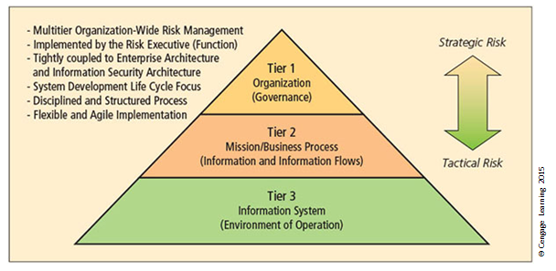
Figure 10-4 Tiered Risk Management Framework

Slide 40
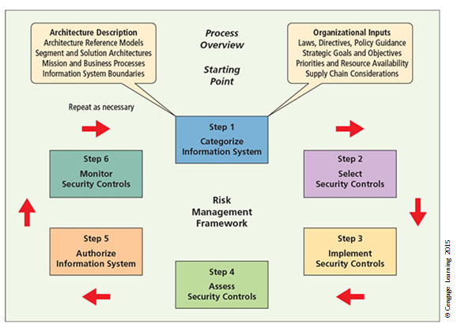
Figure 10-5 Risk Management Framework

Slide 41
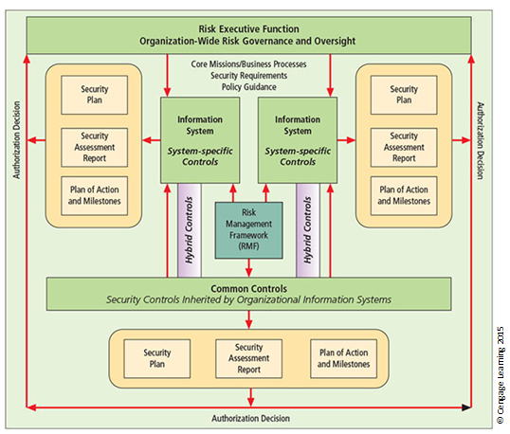
Figure 10-6 Security control allocation from NIST SP 800-37, Rev.1

Slide 42
NSTISS Certification and Accreditation
National security interest systems have their own C&A standards.
NSTISS Instruction 1000: National Information Assurance Certification and Accreditation Process (NIACAP)
Establishes minimum national standards for certifying/accrediting national security systems
Designed to certify that the IS meets documented requirements
Composed of four phases: definition, verification, validation, and post accreditation
Notes:
NSTISS Certification and Accreditation
National security interest systems have their own C&A standards
NSTISS Instruction 1000: National Information Assurance Certification and Accreditation Process (NIACAP)
Establishes minimum national standards for certifying/accrediting national security systems
Designed to certify that IS meets documented requirements
Composed of four phases: Definition, Verification, Validation, and Post Accreditation

Slide 43
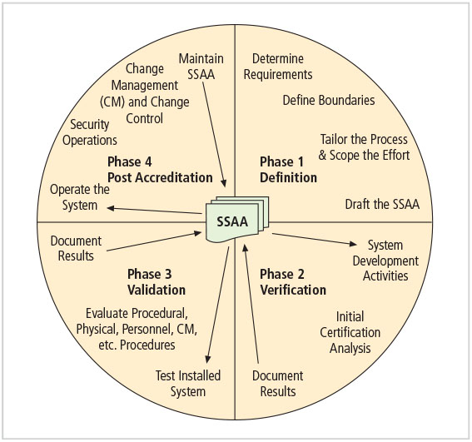
Figure 10-7 Overview of the NIACAP process
Source: NSTISSI-1000.

Slide 44
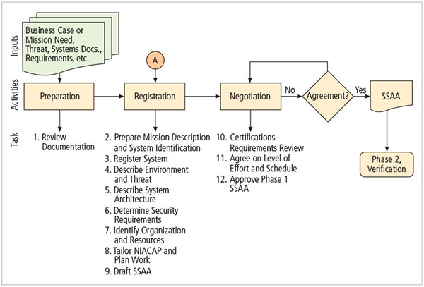
Figure 10-8 NIACAP Phase 1, Definition
Source: NSTISSI-1000.

Slide 45
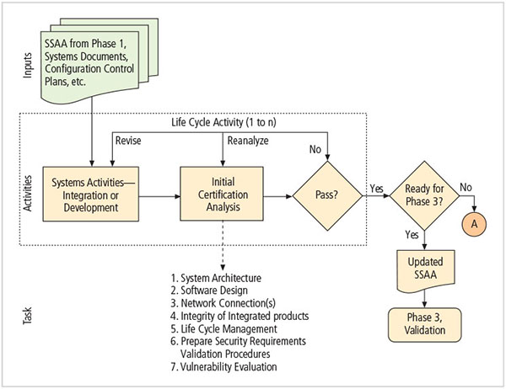
Figure 10-9 NIACAP Phase 2, Verification
Source: NSTISSI-1000.

Slide 46
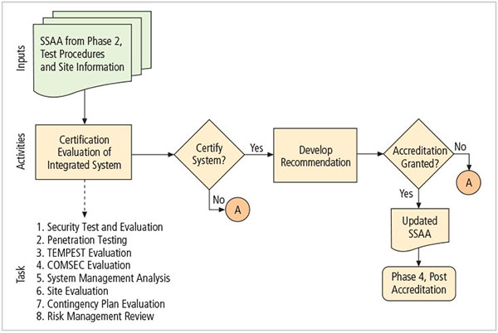
Figure 10-10 NIACAP Phase 3, Validation
Source: NSTISSI-1000.

Slide 47
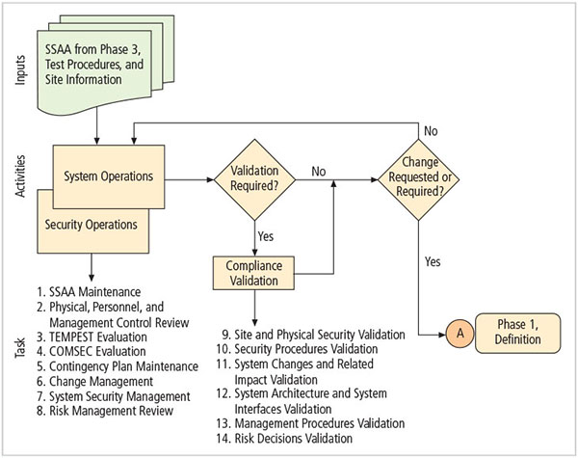
Figure 10-11 NIACAP Phase 4, Post Accreditation
Source: NSTISSI-1000.

Slide 48
ISO 27001/ 27002 Systems Certification and Accreditation
Organizations outside the United States apply these standards.
Standards were originally created to provide a foundation for British certification of information security management systems (ISMSs).
Organizations wishing to demonstrate their systems have met this international standard must follow the certification process.
Notes:
ISO 27001/27002 Systems Certification and Accreditation
Organizations outside the United States apply the standards provided under these standards
Standards were originally created to provide a foundation for British certification of information security management systems (ISMSs)
Organizations wishing to demonstrate their systems have met this international standard must follow the certification process

Slide 49
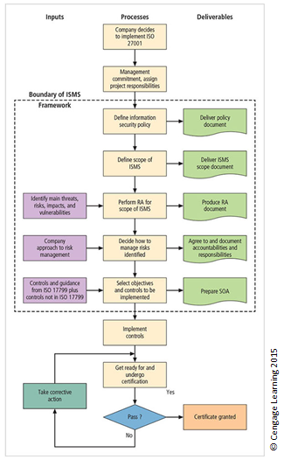
Figure 10-12 ISMS certification and accreditation

Slide 50
Summary
Moving from security blueprint to project plan
Organizational considerations addressed by project plan
Project manager’s role in the success of an information security project
Technical strategies and models for implementing project plan
Nontechnical problems that organizations face in times of rapid change

